Slide 1










Industry Session Data Preparation for Machine Learning
By: Deepak Gupta

Slide 2










Objective
HR Analytics
Perform extensive EDA
What is Data Leakage?
Cross Validation
Using Pipelines
Data Balancing

Slide 3
INDUSTRY SESSION
DATA LEAKAGE
Proprietary content. ©Great Learning. All Rights Reserved. Unauthorized use or distribution prohibited

Slide 4
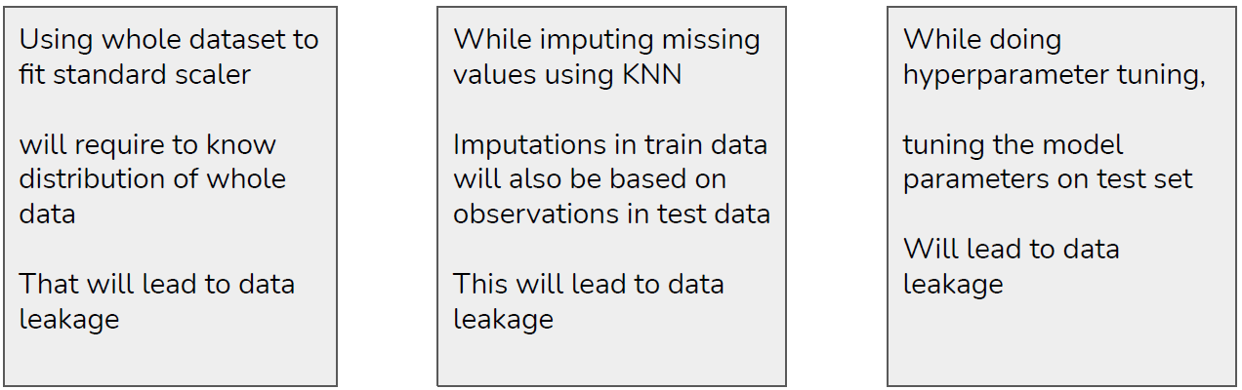
INDUSTRY SESSION
DATA LEAKAGE
Data leakage is when information from outside the training dataset is known to model during the training process
Sharing of any kind of information between testing and training sets leads to data leakage
Data leakage can cause you to create overly optimistic, if not completely invalid, predictive
models
Proprietary content. ©Great Learning. All Rights Reserved. Unauthorized use or distribution prohibited

Slide 5
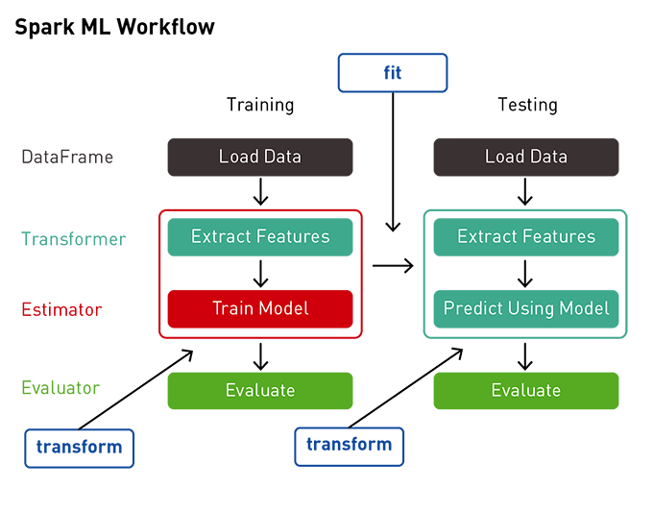
INDUSTRY SESSION
HOW TO PREVENT DATA LEAKAGE
Scale train and test set separately
Normalize train and test sets separately
Hyperparameter tuning should be done on validation set or using cross validation and not on test set
For missing value imputation, fit the imputer on train set and then transform the train and test sets
To do all the above efficiently, we can use pipelines in sklearn
Proprietary content. ©Great Learning. All Rights Reserved. Unauthorized use or distribution prohibited

Slide 6
INDUSTRY SESSION
BUILDING PIPELINES
Proprietary content. ©Great Learning. All Rights Reserved. Unauthorized use or distribution prohibited

Slide 7
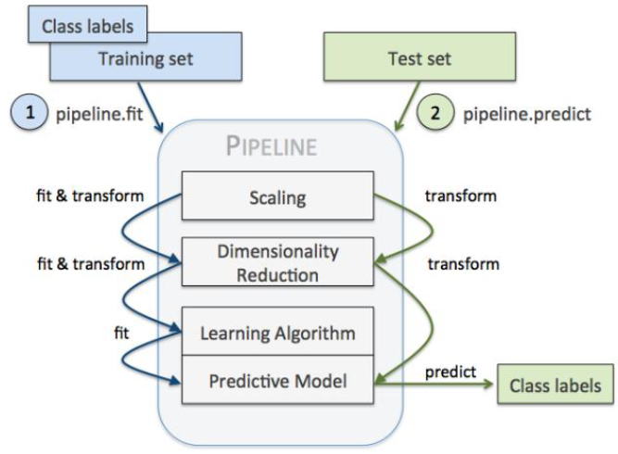
INDUSTRY SESSION
BUILDING PIPELINES
Almost always, we need to tie together many different processes that we use to prepare data for machine learning based model
It is paramount that the stage of transformation of data represented by these processes are standardized
Pipeline class of sklearn helps simplify the chaining of the transformation steps and the model
Pipeline, along with the GridsearchCV helps search over the hyperparameter space applicable at each stage
Steps Involved
Sequentially apply a list of transforms and a final estimator
Intermediate steps of the pipeline must be ‘transforms’, that is, they must implement fit and transform methods
The final estimator only needs to implement fit
Helps standardize the model project by enforcing consistency in building testing and production
Proprietary content. ©Great Learning. All Rights Reserved. Unauthorized use or distribution prohibited

Slide 8
INDUSTRY SESSION
K-FOLD CROSS VALIDATION
Proprietary content. ©Great Learning. All Rights Reserved. Unauthorized use or distribution prohibited

Slide 9
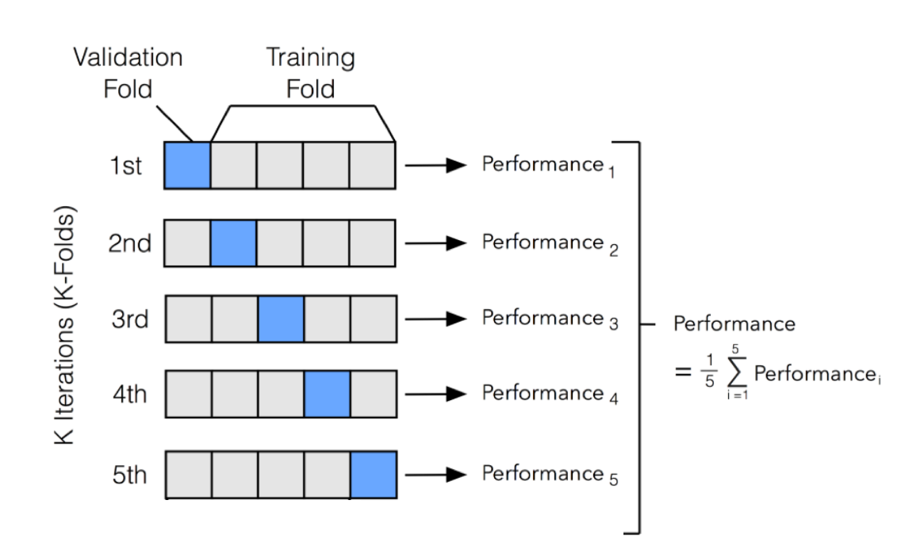
INDUSTRY SESSION
K-FOLD CROSS VALIDATION
Cross validation is a technique used for evaluating models
K fold Cross validation will divide data into k-folds
Train model on k-1 folds and test its performance on the last fold
K fold cross validation will generate k models and k performance scores
Instead of getting only 1 score, here we’ll get k scores, which will give a better picture of the variance in model performance
Proprietary content. ©Great Learning. All Rights Reserved. Unauthorized use or distribution prohibited

Slide 10
INDUSTRY SESSION
DATA BALANCING TECHNIQUES
Proprietary content. ©Great Learning. All Rights Reserved. Unauthorized use or distribution prohibited

Slide 11
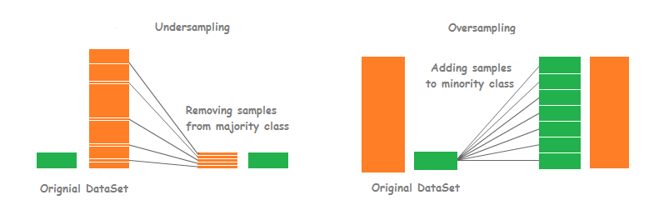
INDUSTRY SESSION
DATA BALANCING TECHNIQUES
Datasets used in banking, health and market analytics usually have imbalance i.e. one class is in majority and one is in minority (less than 5%)
During training on such datasets, model gives more weightage to majority class and gets biased
To avoid such situations, we can use oversampling or undersampling techniques on data
Oversampling will create artificial data points for minority class
Undersampling will remove data points from majority class
We can’t afford losing data points in case of small data size, so oversampling is preferred in such cases
Proprietary content. ©Great Learning. All Rights Reserved. Unauthorized use or distribution prohibited

Slide 12
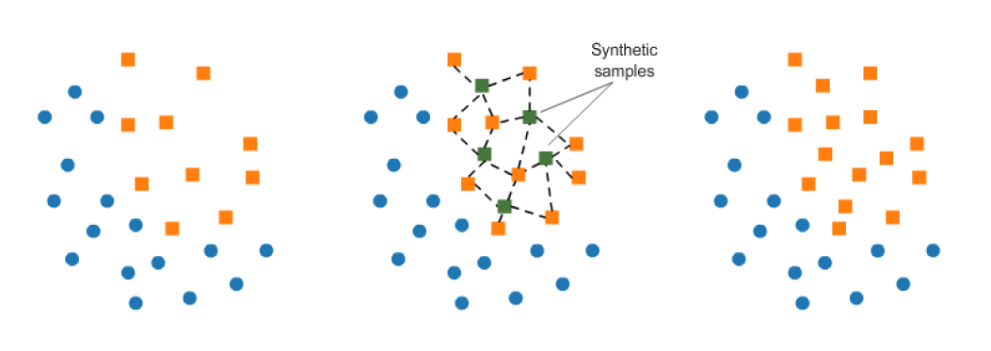
INDUSTRY SESSION
SMOTE (Synthetic Minority Oversampling TEchnique)
Consists of synthesizing elements for the minority class, based on those that already exist.
It works randomly picking a point from the minority class and computing the k-nearest neighbors for this point.
Synthetic points are added between the chosen point and its neighbors.
Proprietary content. ©Great Learning. All Rights Reserved. Unauthorized use or distribution prohibited

Slide 13
INDUSTRY SESSION
CASE STUDY
An Ed-Tech company wants to hire data scientists among people who have successfully passed some courses and then signed up for training. The company wants to know which of the people are really looking for a job change and will prefer working with them, after completion of training because it helps to reduce the cost and time for categorization of candidates.
Information related to demographics, education, the experience is in hands from candidates signup and enrollment.
Proprietary content. ©Great Learning. All Rights Reserved. Unauthorized use or distribution prohibited

Slide 14









HAPPY LEARNING

